Slide 1
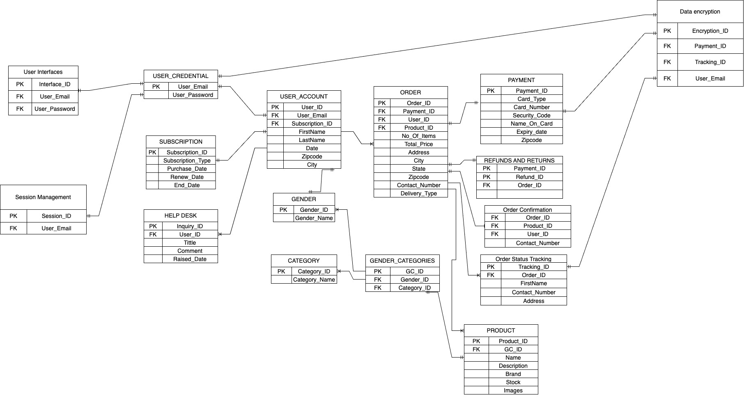
STYLE-X ER-DIAGRAM SCOPE : SPRINT 3

